Slide 1
From anatomical images to functional models
Harvey Davis

Slide 2
Aims
To understand the methods of experimental imaging that are commonly used by physiologists
To understand the advantages and limitations of these techniques
To understand which datasets to choose from the literature or which collaborators to choose

Slide 3
Use case
We want to produce a model of blood flow control (at a microvascular level) in skeletal muscle

Slide 4
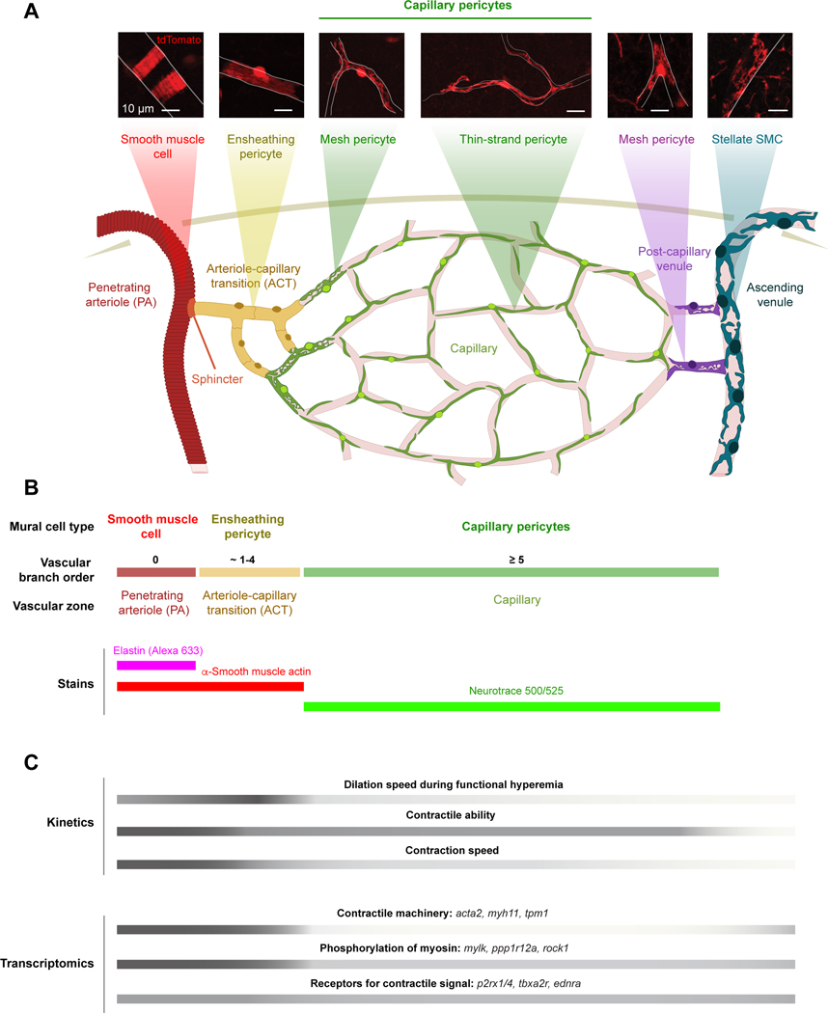
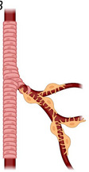
How are vascular diameters regulated?
Principally by vascular smooth muscle cells and capillary pericytes
BO1
BO2
BO3
BO4
BO3
BO4
Hartmann et al., 2022

Slide 5
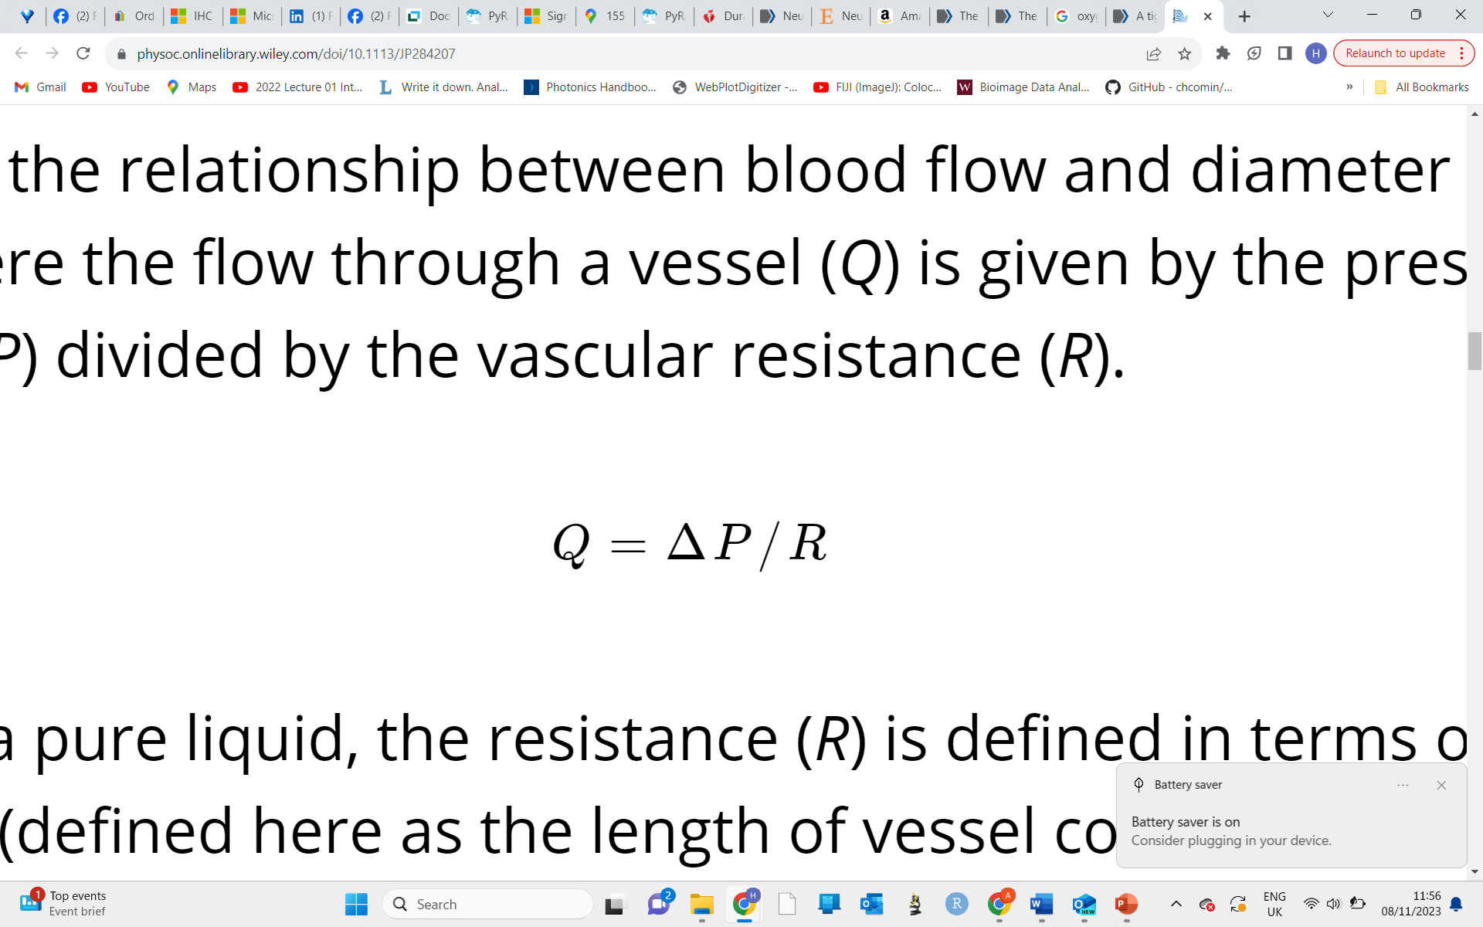
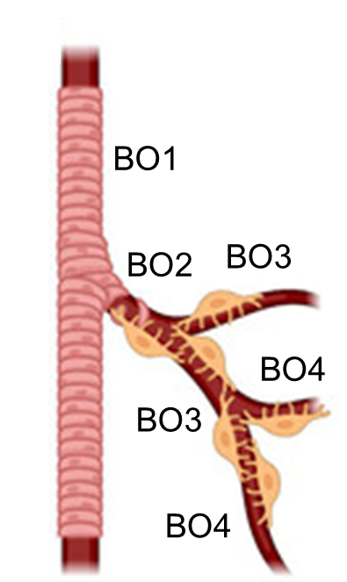
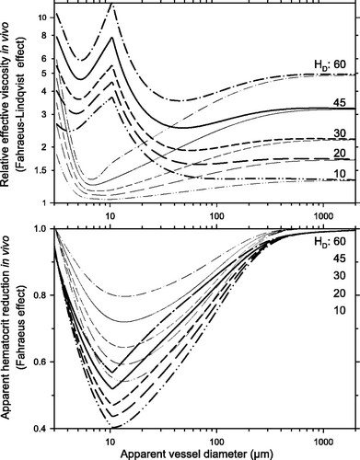
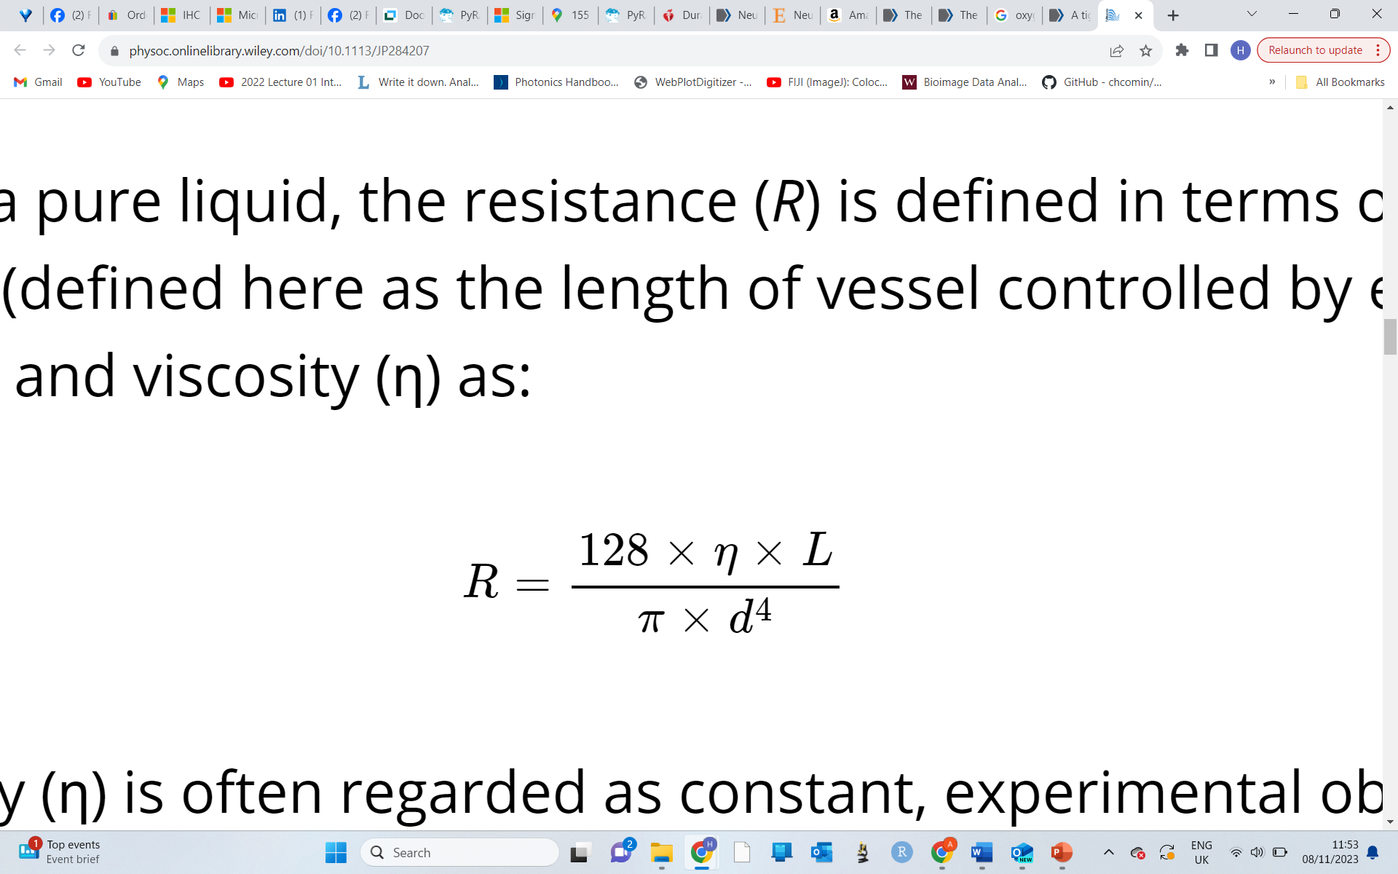


How is blood flow regulated?
Largely by changes in diameter
Q = Flow, P = Pressure, R = Resistance
η = Visoscity, L = Vessel length
d = Vessel diameter

Slide 6
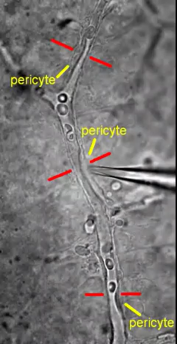
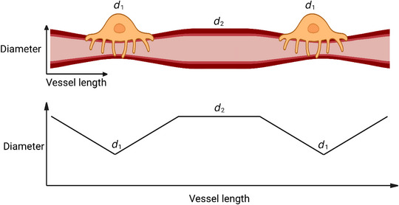
Pericytes generally constrict focally
Peppiatt et al., 2006

Slide 7
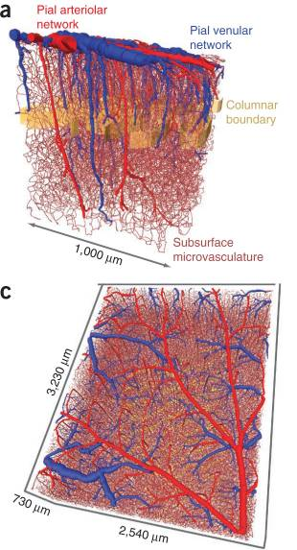
However, pericyte capillary constriction still greatly contributes to vascular resistance
Total resistance change ratio (% flow decrease)
% change in diameter (whole arteriole or at pericyte soma | Arteriole constriction | Capillary constriction | Combined constriction
10% | 1.097 (8.8%) | 1.185 (16%) | 1.282 (22%)
20% | 1.286 (22%) | 1.488 (33%) | 1.773 (44%)
30% | 1.688 (41%) | 2.024 (51%) | 2.713 (63%)
40% | 2.660 (62%) | 3.083 (68%) | 4.744 (79%)
Davis and Attwell, 2023
Blinder et al., 2013

Slide 8
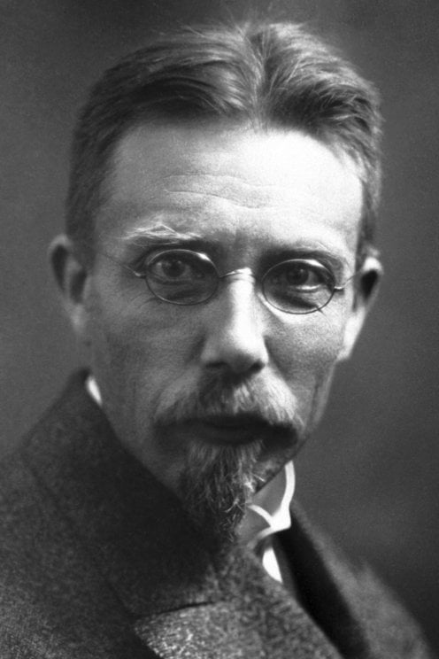
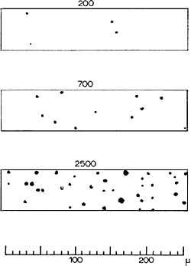
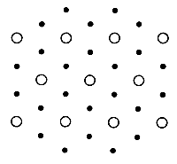
August Krogh proposed a contractile role for pericytes in skeletal muscle
Capillary recruitment hypothesis
Rest
Exercise
Schack August Steenberg Krogh The Nobel Prize in Physiology or Medicine 1920
“for his discovery of the capillary motor regulating mechanism”

Slide 9
This theory is now disputed
A) Krogh’s hypothesis
“Capillary recruitment”
All pericytes
B) Contemporary view
“Longitudinal recruitment”
All arteriolar
We want to know whether pericytes are contractile in skeletal muscle (based upon experimental data), so that we can produce a physiologically accurate model

Slide 10
Use case
We want to produce a model of blood flow control (at a microvascular level) in skeletal muscle
So - what do we need…?
A good representation of physiology (ie physiological vessel diameters, blood pressure)
Images with high enough spatial resolution to find the anatomy and resolve the diameter of microvessel lumens (<3-20 μm)
A fast enough acquisition rate that we can we can achieve a good temporal resolution in order to measure changes in diameter in real time (over minutes)
A large enough dataset to encompass all required anatomy
A ground truth measurement of blood flow function and how this changes after contraction
Localization of pericytes and smooth muscle cells

Slide 11
The problem
The required data cannot be generated simultaneously, nor by the same techniques
(ie receptor localization would be imaged in a different way to measuring blood flow)
The solution
The solution – we need to understand the principles of experimental microscopy in physiological research, so that we can generate the appropriate combination of data.

Slide 12
How would we approach looking at skeletal muscle blood flow
1) A good representation of physiology (ie physiological vessel diameters, blood pressure)

Slide 13
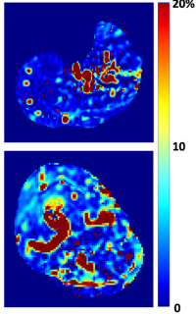
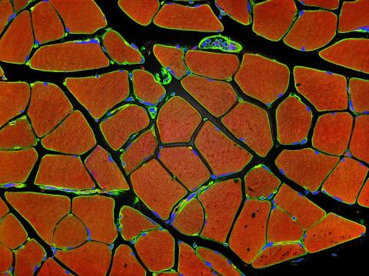
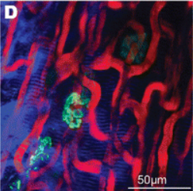
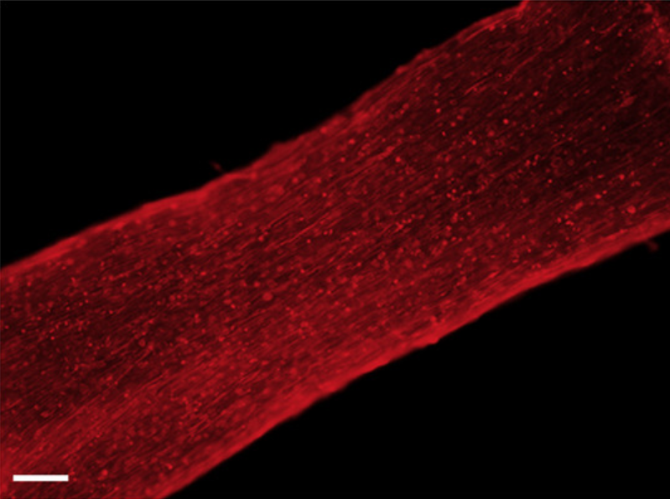
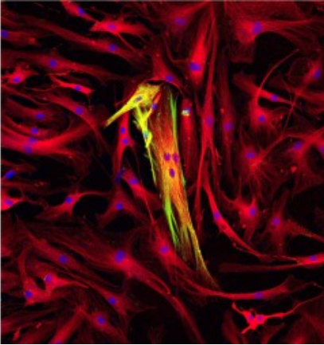
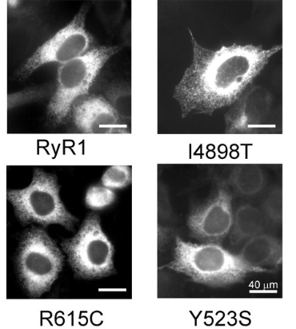
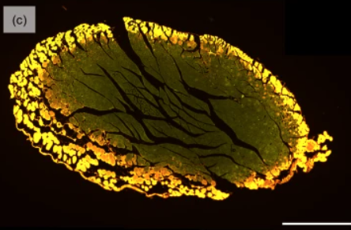
The basics – choosing a physiological preparation to work with
In vitro
“In glass”
Ex vivo (and in situ)
“Out of the living”
In vivo
“In the living”
Live preparations
“Fixed” tissue preparations
Animal experiments
Patient data
Induced pluripotent stem cells
Primary isolated cells or cell culture
Cell lines
Mercier et al., 2016
Maffioletti et al., 2018
Sargent et al., 2024
Tom Deerinck, NIH
Kelc et al., 2013
Brini et al., 2005
Griffith et al., 2024

Slide 14
The basics – choosing a physiological preparation to work with
In vitro
“In glass”
Induced pluripotent stem cells
Primary isolated cells or cell culture
Cell lines
Appropriate usage:
Appropriate usage:
Appropriate usage:
Drug screening (largely for ion channel research)
Work on cellular/subcellular processes
Study of single protein function
Work on patient mutations

Slide 15
The basics – choosing a physiological preparation to work with
In vitro
“In glass”
Better characteristics
for imaging (they are isolated)
Simplified system (they are isolated)
Induced pluripotent stem cells
Primary isolated cells or cell culture
Cell lines
Advantages
Advantages
Advantages
Express human proteins
Isolation from multicellular environment allows for easier manipulation
Able to express a specific human or animal protein of interest in abundance
Can be directly derived from patients
“Somewhat” represents human physiology
Can often adequately represent cellular function
“Cheap”
Can be derived from patients or animals
No animal usage = ethical
No animal usage = ethical

Slide 16
The basics – choosing a physiological preparation to work with
In vitro
“In glass”
Isolation loses the diversity and complexity found in physiology
A cells identity is often defined by its local environment
Induced pluripotent stem cells
Primary isolated cells or cell culture
Cell lines
Disadvantages
Disadvantages
Disadvantages
“Somewhat” represents physiology
Fresh isolation can damage cells
Use is generally limited to the study of a single protein or system
Expensive
Culturing cells often changes cells properties
Not physiological
Hard to get enough freshly isolated patient tissue

Slide 17
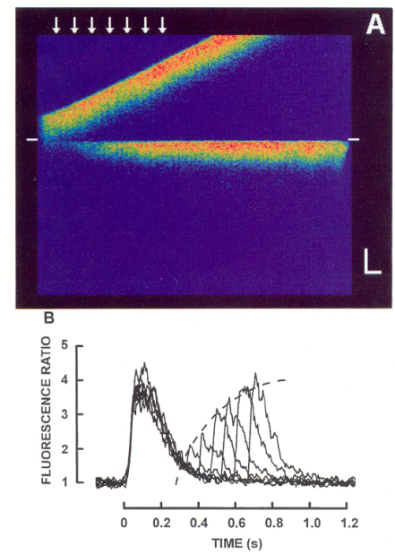
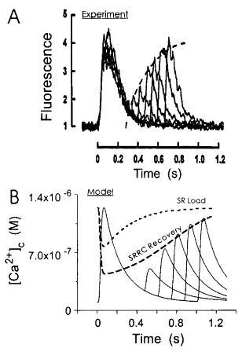
In vitro use case – modelling calcium handling in cardiomyocytes
Confocal intracellular calcium imaging study of cardiomyocyte calcium sparks
Cheng et al., 1996
Snyder et al., 2000

Slide 18
The basics – choosing a physiological preparation to work with
Ex vivo
“Out of the living”
Live preparations
“Fixed” tissue preparations
Appropriate usage:
Appropriate usage:
Testing of function of cells whilst surrounded by a somewhat physiological environment
Localisation of proteins and cells, for example by immunohistochemistry
Testing of local intercellular interactions (ie to see how a perivascular cell constricts an associated blood vessel)
Studying static morphology of physiological structures
Testing of whole organ function (ie Langendorff isolated heart preparation)

Slide 19
The basics – choosing a physiological preparation to work with
Ex vivo
“Out of the living”
Live preparations
“Fixed” tissue preparations
Advantages
Advantages
More physiological than isolated or cultured cells
Versatile range of targets
Multiple targets can be imaged simultaneously
Not reliant on systemic physiology
Relatively easy to control the tissues environment
Disadvantages
Disadvantages
Tissue is not living (its fixed)
Not reliant on systemic physiology
Fixation causes tissue shrinkage
Tissue is typically damaged during isolation

Slide 20
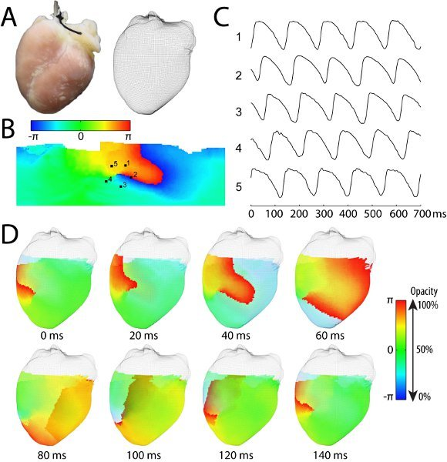
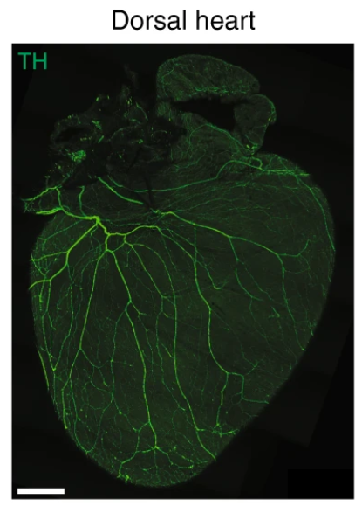
Ex vivo use case – studying the isolated heart
Living ex vivo preparation of the heart (Langendorff)
Labelling of the network of sympathetic neurons in the isolated heart (Fixed)
Lou et al., 2011
Rajendran et al., 2019

Slide 21
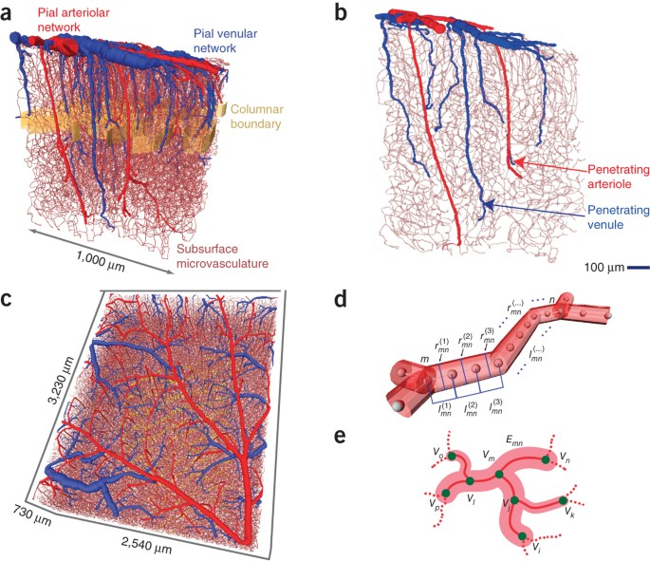
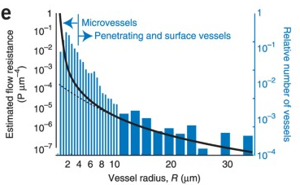
Ex vivo use case – modelling the cerebral vasculature
Resistance network model based off ex vivo fixed tissue imaging
Blinder et al., 2013

Slide 22
The basics – choosing a physiological preparation to work with
In vivo
“In the living”
Animal experiments
Patient data
Appropriate usage:
Appropriate usage:
Systems level physiology
Ideal (Only?) datasets for studying control and disease in actual human environment
Behaviour
Disease models

Slide 23
The basics – choosing a physiological preparation to work with
In vivo
“In the living”
Animal experiments
Patient data
Advantages
Advantages
Good representation of physiological in an intact system
Best case datasets
Generally non-invasive methodologies
Imaging depth and location is limited (at high resolution)
Disadvantages
Hard to obtain data and even harder to get well controlled baseline datasets
Disadvantages
Imaging/experimental manipulation is often invasive
Limited ability for experimental intervention
Often involves anaesthesia
Imaging techniques are often low resolution
Ethical considerations

Slide 24
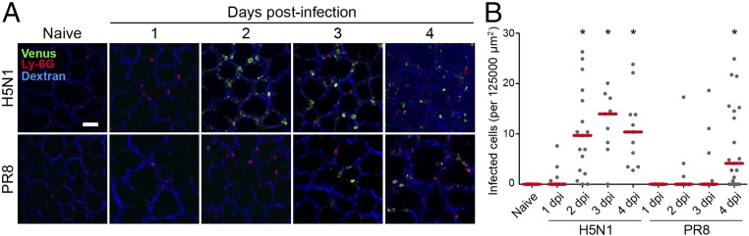
In vivo use case – studying immune cell movement into the lung in influenza
Venus = Fluorescent flu virus
Ueki et al., 2018

Slide 25
Take home
Do you want to isolate a cell, tissue/organ or look at a whole functioning system? There are advantages and disadvantages of each approach, and we can combine methods to optimize their usage

Slide 26
How would we approach looking at skeletal muscle blood flow
Images with high enough spatial resolution to find the anatomy and diameter of microvessel lumens (<3-20 μm)
A fast enough acquisition rate that we can we can achieve a good temporal resolution in order to measure changes in diameter in real time (over minutes)
A large enough dataset to encompass all required anatomy

Slide 27
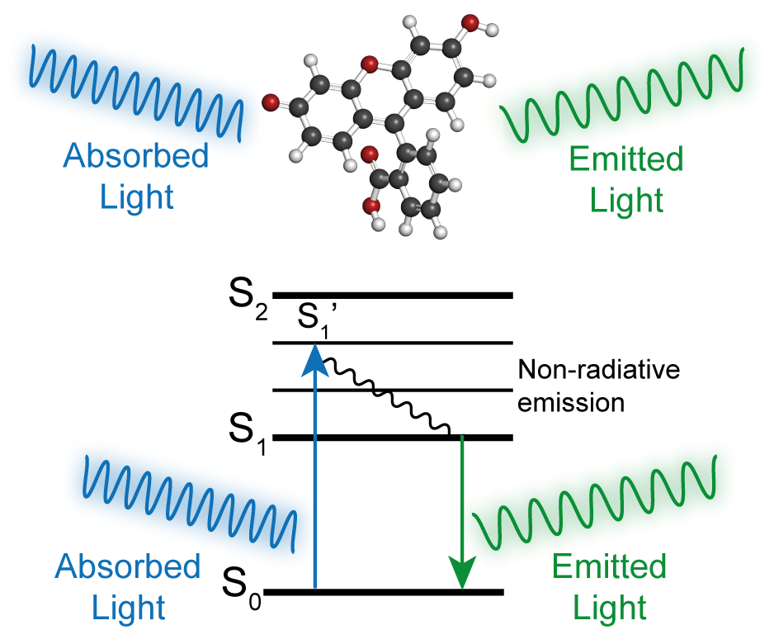
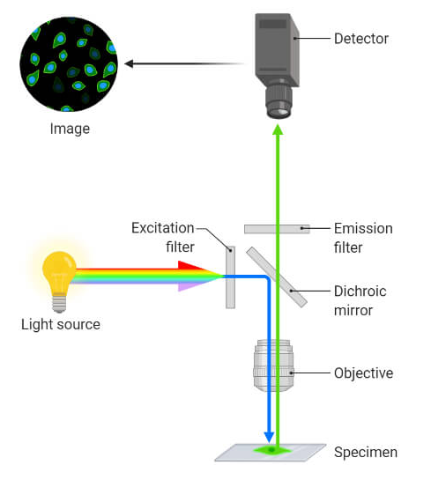
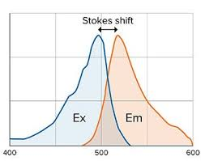
Basic overview of (fluorescence) light microscopy

Slide 28
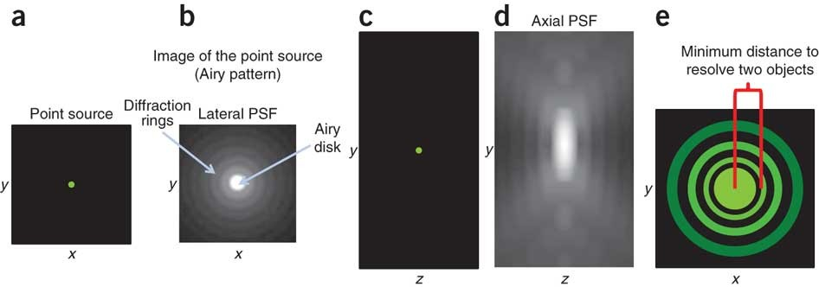
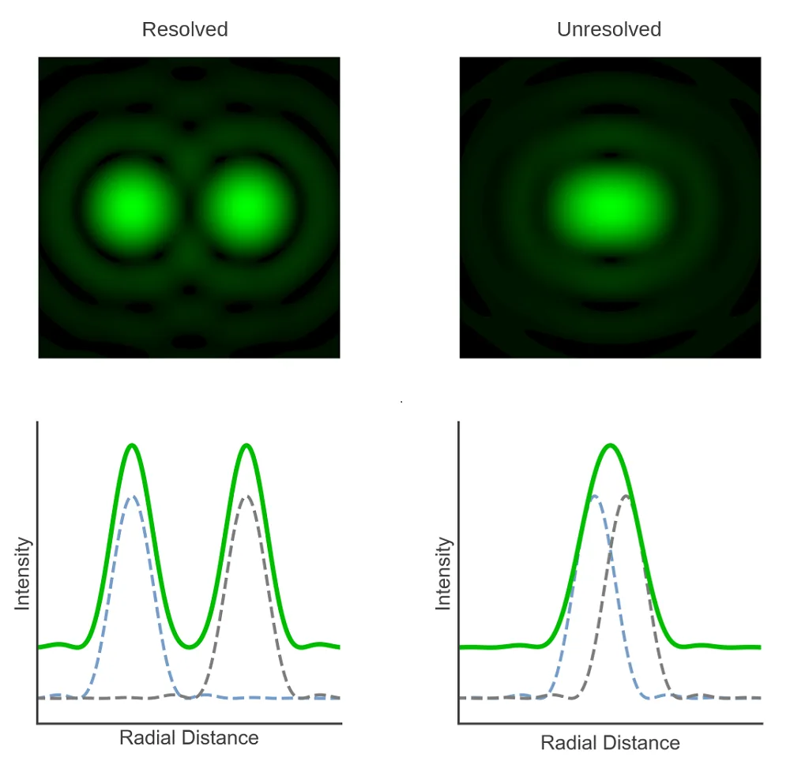
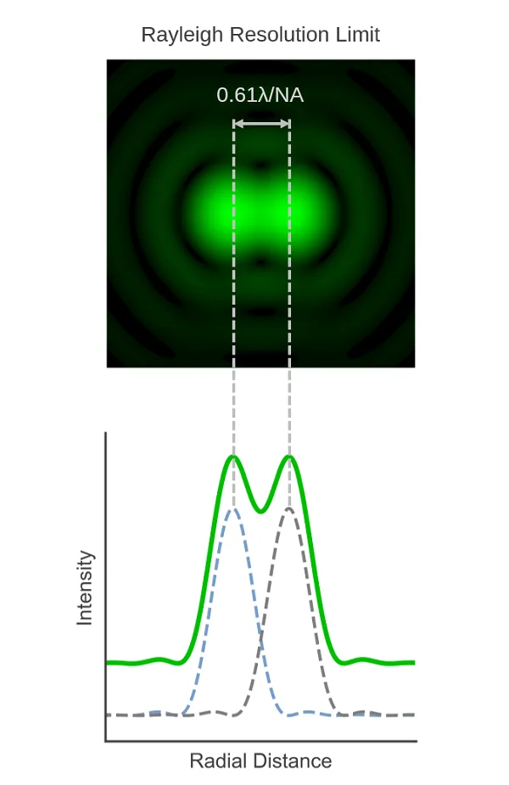
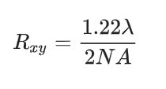
Every fluorescent molecule will have a point spread function limiting imaging resolution

Slide 29
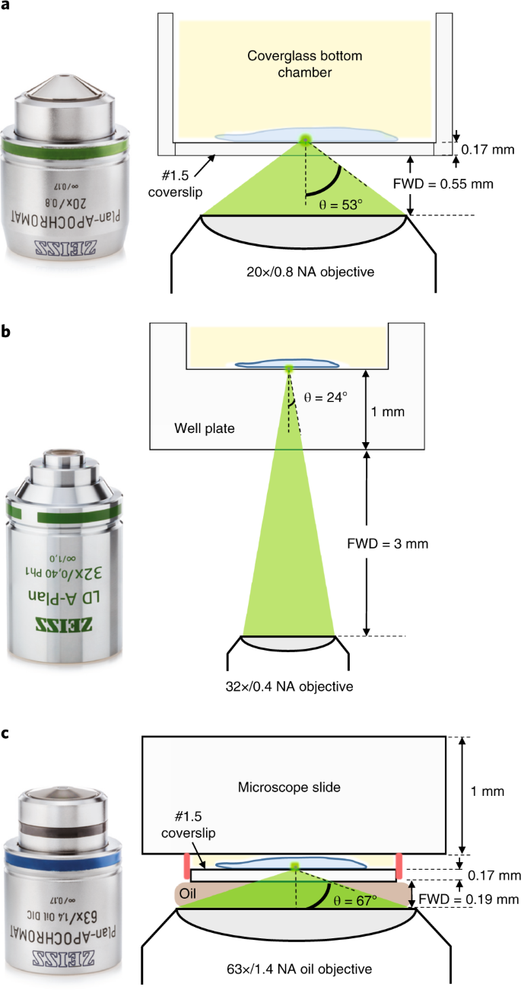

How the numerical aperture of the objective limits spatial resolution
Lateral (single plane x/y) resolution is determined by the following equation
Microscope objective choice effects resolution, working distance, applicability (ie is the sample in solution or under a coverslip), magnification and brightness

Slide 30
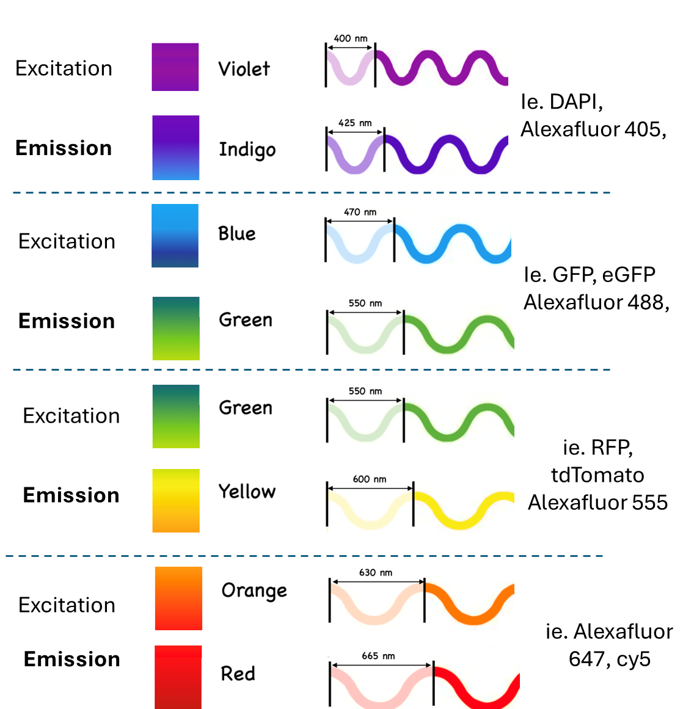
How the emission wavelength limits spatial resolution
Approximate
Lateral (single plane x/y) resolution is determined by the following equation

Slide 31
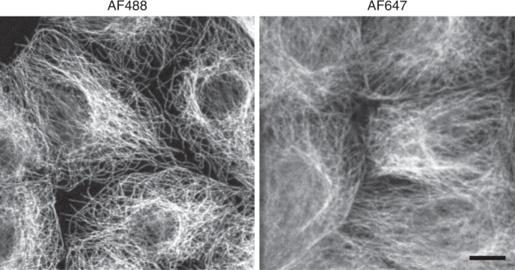
How the emission wavelength limits spatial resolution
Lateral (single plane x/y) resolution is determined by the following equation
Jonkman et al., 2020

Slide 32
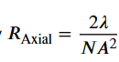
Resolution is worse in the axial (z) dimension
Lateral (single plane x/y) resolution is determined by the following equation
Axial (depth - z) resolution is determined by the following equation and therefore worse than the xy resolution

Slide 33
Take home
An image file you generate or are given, may have a voxel size that is smaller than the physical resolution limit.
The physical limit should always be the main consideration!
Make sure you know how the image was acquired, and do not over interpret your data.

Slide 34
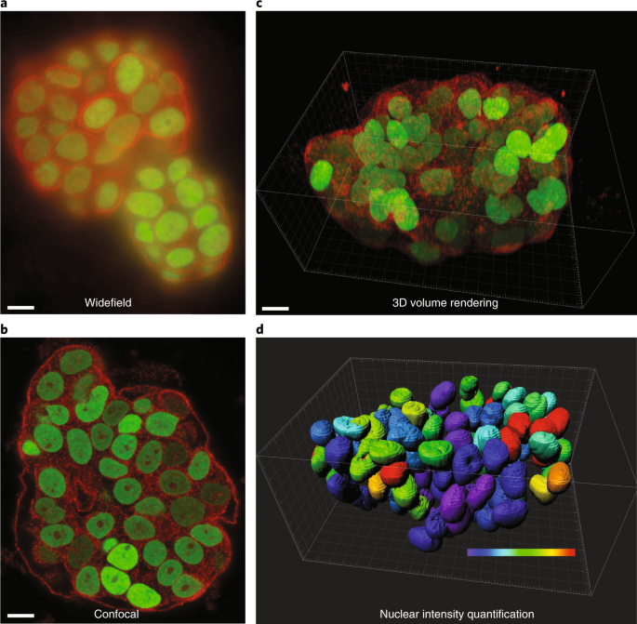
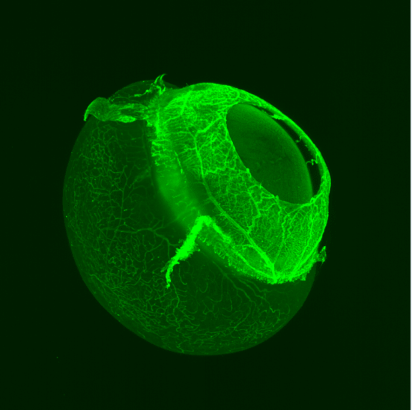
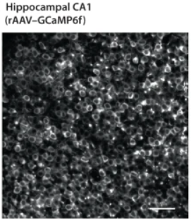
Common types of light microscopy
Confocal
microscopy
Lightsheet
microscopy
Widefield
microscopy
Multiphoton
microscopy
Jonkman et al., 2020
Jonkman et al., 2020
Greinberger et al., 2022
Prahst et al., 2020

Slide 35
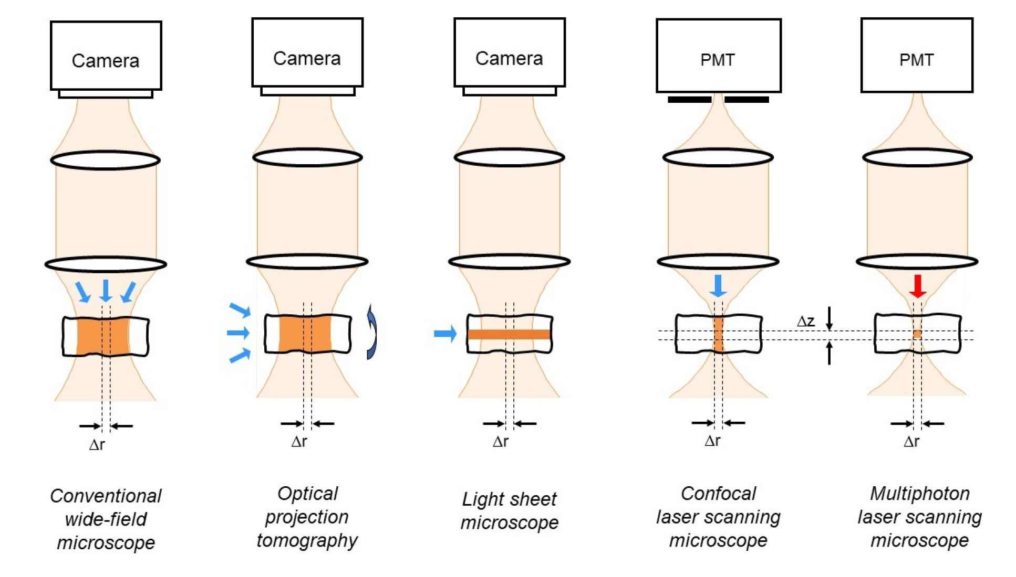
These techniques differ in how we deliver and collect light and each provide different advantages and disadvantages

Slide 36
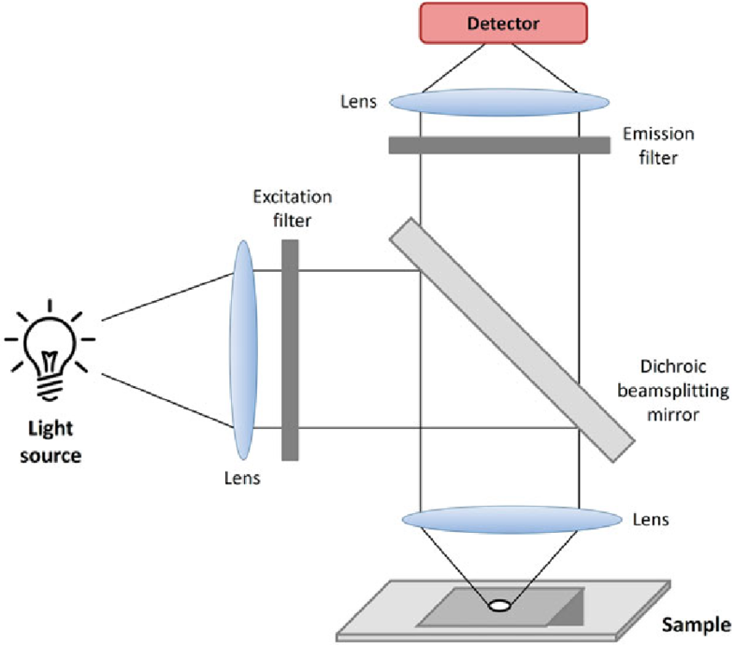
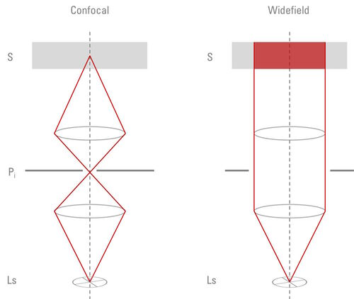
Wide field microscopy

Slide 37
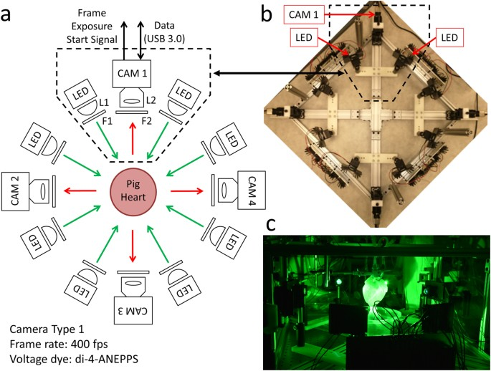
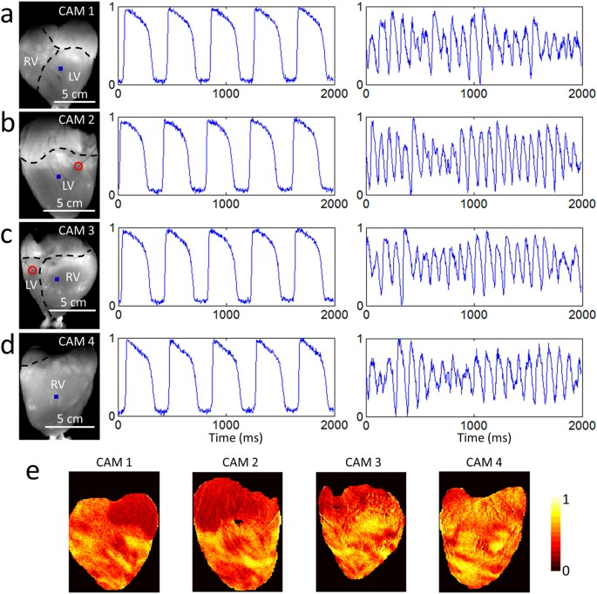
Wide-field example usage
Lee et al., 2017

Slide 38
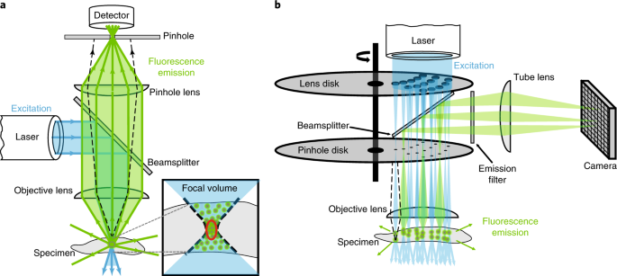
Confocal microscopy – basic principles

Slide 39
Confocal microscopy – basic principles
Widefield
microscopy
Confocal
microscopy
Jonkman et al., 2020
Jonkman et al., 2020

Slide 40
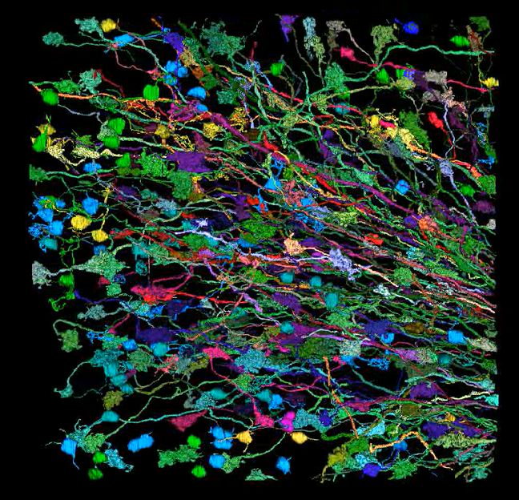
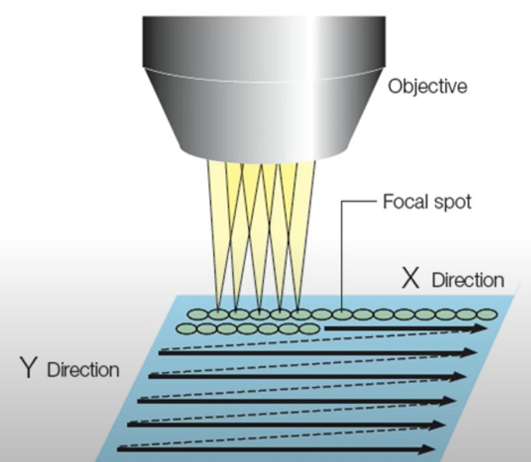
“3D” imaging with confocal microscopy
Due to point scanning, and filter set changes there is a time-cost for imaging in x, y and z. When live imaging, this can mean that when imaging in z, the bottom and top of the 3D image are at different timepoints.
Livet et al., 2007

Slide 41
Common variants of confocal microscopy
Can be used in vitro, ex vivo and in vivo
Confocal laser-scanning microscopy
Spinning disk
Confocal microscopy
Allow for high resolution images resolved in 3D
Confocal laser-scanning microscopy
Most common type of confocal microscopy
Slower, but with better image quality
Speed limited by movement of focal volume, changing between wavelengths and exposure time
Spinning disk confocal microscopy
Very fast, but at the expense of brightness (due to exposure time) and image quality
Jonkman et al., 2020
Less commonly used

Slide 42
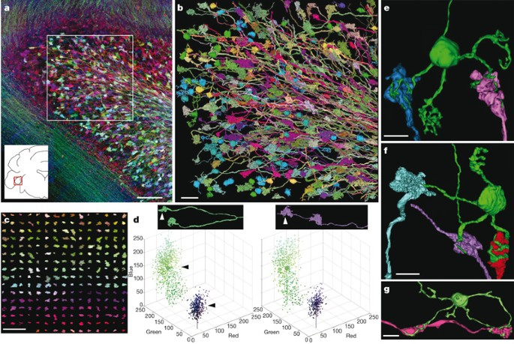
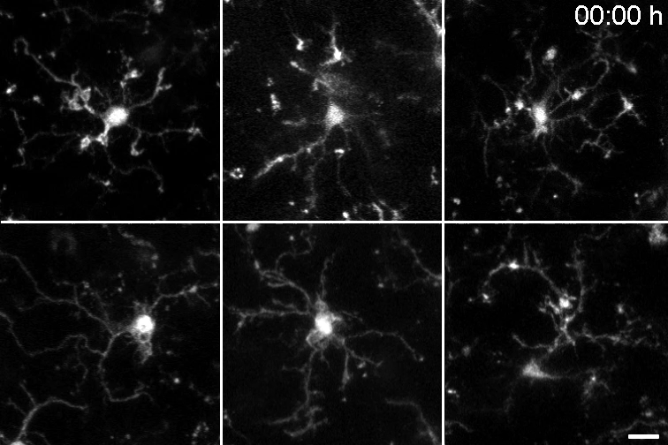
Confocal microscopy example usages
Neuronal tracing in fixed tissue Confocal imaging in “brainbow” mice
Imaging microglia movement ex vivo
Confocal imaging
Berki et al., 2024
Livet et al., 2007

Slide 43


Spinning disk confocal microscopy example usage – tracking axonal action potentials
Foust et al., 2010

Slide 44


Light sheet microscopy
Zeiss

Slide 45


Lightsheet microscopy example usage
Zebra fish vascular tube development
SPIM lightsheet microscopy
Zeiss
Kaufmann et al., 2012

Slide 46


Multiphoton microscopy principles
Soliman, 2012

Slide 47


Multiphoton microscopy achieves high imaging depth
Polisseni, 2024
Xu et al., 2024

Slide 48

Multiphoton microscopy example usage
2-photon imaging, mouse cortex, blood plasma highlighted by dextran dye
Hartmann et al., 2021

Slide 49

Quick comparison of these techniques
Speed
Dimensions
Faster techniques
Slower techniques
Z resolved
Not resolved in Z
Lightsheet microscopy
Laser-scanning
confocal microscopy*
Spinning disk confocal
microscopy
Widefield
Spinning disk confocal
microscopy
2-photon microscopy*
Lightsheet microscopy
Widefield
2-photon microscopy
*Faster speed can be achieved through 1D line-scanning (without Z or Y dimensions)
Laser-scanning
confocal microscopy
XY resolution
Very high
High
Laser-scanning
confocal microscopy
Spinning disk confocal
microscopy
Jonkman et al., 2020
2-photon microscopy
Lightsheet microscopy**
Widefield
*Depends upon lightsheet variation

Slide 50
Take home
There is now a wide range of commonly used microscopy techniques to acquire high resolution fluorescence-based datasets.
These each have advantages and disadvantages, and the choice of the correct technique is essential to ensure that the dataset is your appropriate to your use case.

Slide 51
How would we approach looking at skeletal muscle blood flow
5) A ground truth measurement(s) of blood flow function and the ability to perturb the system, in order to dissect the mechanism

Slide 52




Low-resolution in vivo measurements of blood flow
functional Magnetic Resonance
Imaging
Laser speckle contrast imaging
Laser doppler
Binder et al., 2024
Warren et al., 2006
Tahmoush et al., 1983
Adapted from Shih et al., 2012

Slide 53



Measurements of blood flow at a capillary level can be achieved by multiphoton imaging
Control
Pericyte stimulation
Hartmann et al., 2021

Slide 54
Take home
Blood flow measurements can be achieved by a variety of techniques depending on need.
The major tradeoffs are tissue depth, scale and resolution.

Slide 55
How would we approach looking at skeletal muscle blood flow
6) Localization of proteins (and other cell machinery) essential to contextualising functional data

Slide 56


Proteins are commonly localized via antibodies (ie in immunohistochemistry), dyes or via genetic reporter lines
Lysm-GFP
Sekimoto et al., 2015

Slide 57

These methods can be used in conjunction with tissue clearing (or alternative methods) to improve volumetric imaging
Matsumoto et al., 2019
This allows for deeper tissue imaging, and is often used alongside lightsheet, confocal and multiphoton microscopy.
Requires the tissue to be fixed, so not applicable to live imaging.
Multiple methodologies are available, but all cause a change in tissue size (as does fixation)

Slide 58
Take home
There are number of ways to visualize proteins, with can be used in vitro, ex vivo and in vivo
For Ex vivo we can improve imaging using clearing methods

Slide 59
The controversy
A) Krogh’s hypothesis
“Capillary recruitment”
All pericytes
B) Contemporary view
“Longitudinal recruitment”
All arteriolar
We want to know whether pericytes are contractile in skeletal muscle (based upon experimental data), so that we can produce a physiologically accurate model

Slide 60
We want to know whether pericytes are contractile in skeletal muscle (based upon experimental data), so that we can produce a physiologically accurate model

Slide 61


Ex vivo imaging allows us to confirm pericytes are able to contract
Smooth muscle actin is expressed in a majority of pericytes by IHC
IB₄ dye to visualize vascular basement membrane
Antibodies to label against NG2 (pericytes) and smooth muscle actin
Ex vivo confocal imaging of live skeletal muscle
Ex vivo confocal imaging of fixed skeletal muscle

Slide 62

In vivo imaging allows us to observe anatomy and vessel diameters
Z projection of z-stack, 2-photon imaging, in vivo urethane anaesthetized mice, NG2-dsRed genetic reporter line for pericytes
FITC-dextran
NG2-dsRed
Davis, Argus et al., unpublished

Slide 63
Now you are going to model (in a simplified way), what will happen to vascular resistance when we reverse resting noradrenergic pericyte contraction

